Slide 1
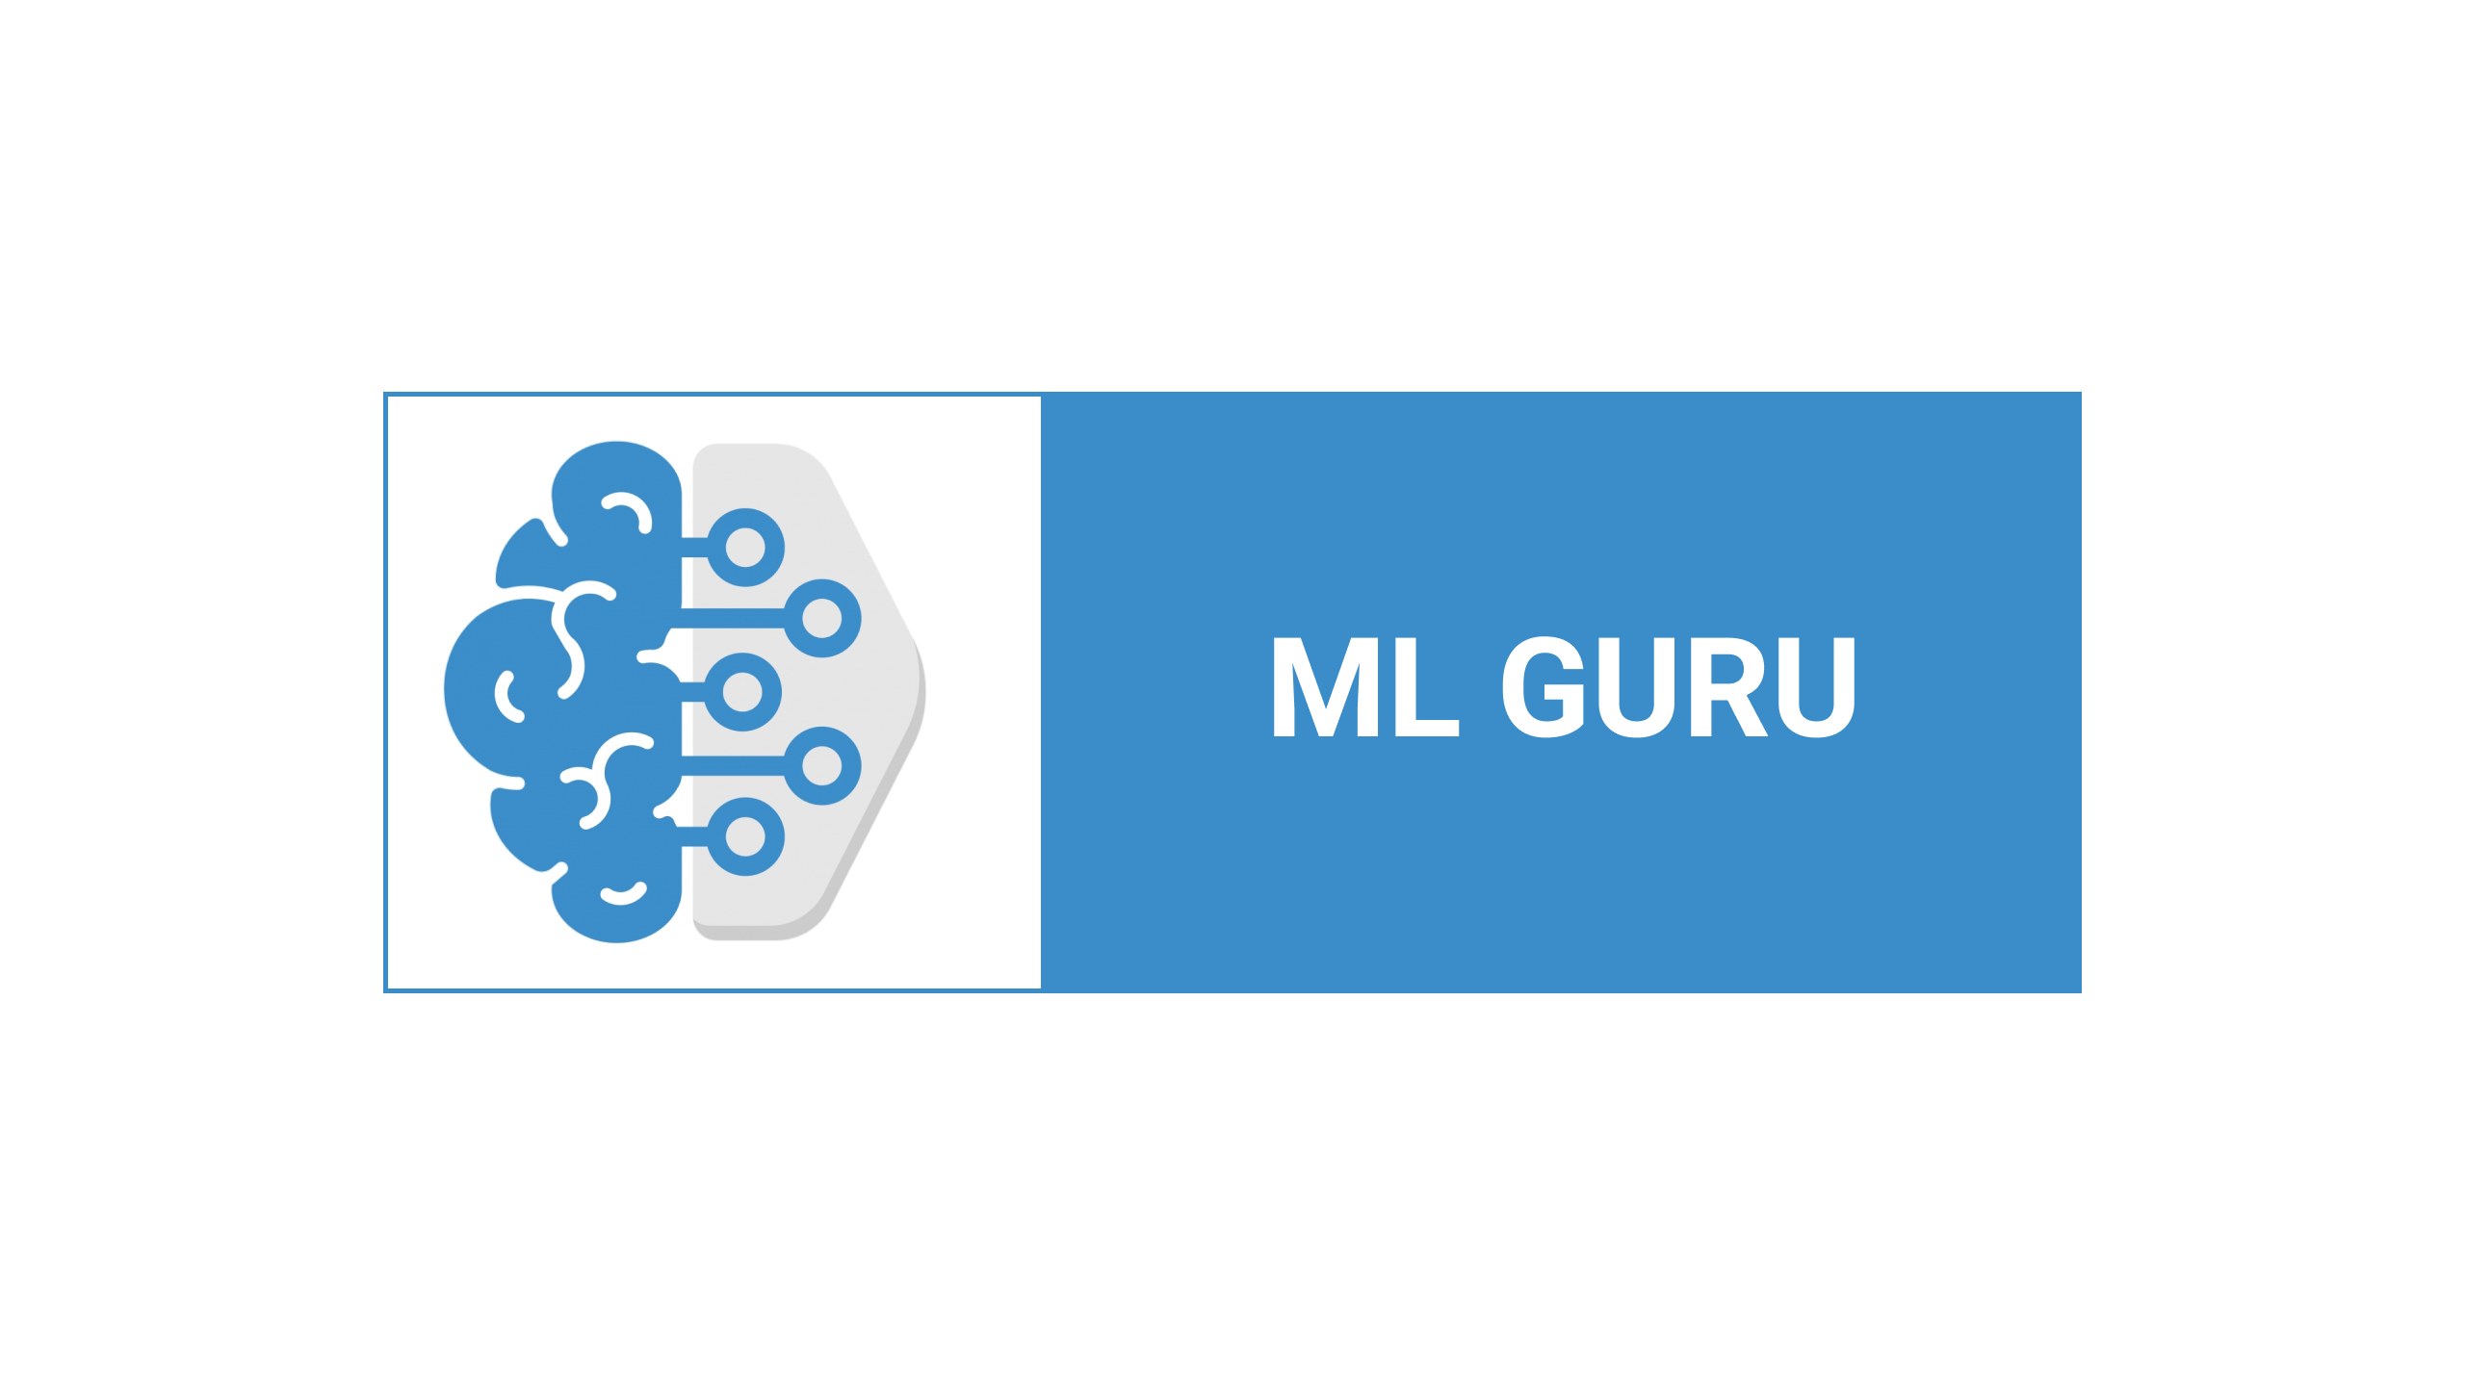

Slide 2
Lecture By Arjun Pukale

Slide 3
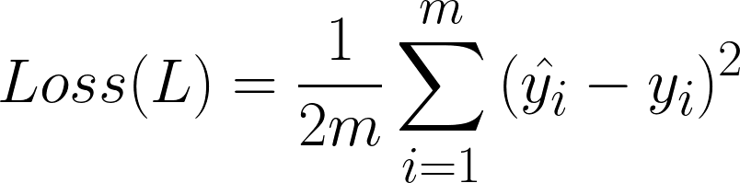
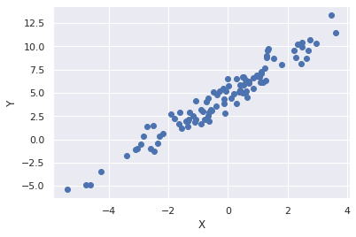




RECAP
X | Y
-1.5 | -2 | -1.7
-1.25 | -1 | -0.9
-1 | 0 | -0.3
-0.75 | -1.5 | -1.2
-0.2 | -0.5 | -0.3
0 | 0.7 | 0.4
…… | …… | ……
Loss depends on w,b
Update w,b such that Loss is reduced

Slide 4
RECAP
X | Y
-1.5 | -2 | -1.8
-1.25 | -1 | -1
-1 | 0 | -0.2
-0.75 | -1.5 | -1.3
-0.2 | -0.5 | -0.35
0 | 0.7 | 0.6
…… | …… | ……
Loss depends on w,b
Update w,b such that Loss is reduced
Goal: Find optimum value of w,b such that Loss is minimum

Slide 5
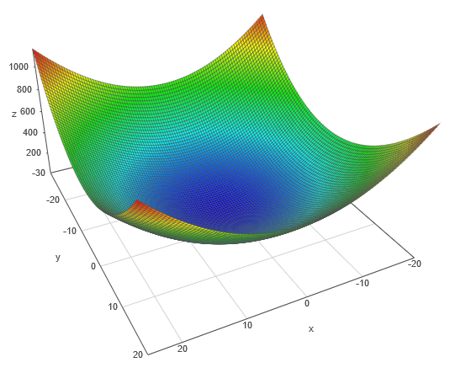
Loss Surface
Loss
b
w

Slide 6
Loss Surface
Randomly initialise w,b
Loss
b
w

Slide 7
Loss Surface
Model
Randomly initialise w,b
Loss
b
w

Slide 8
Loss Surface
Model
Target (Minima)
Loss
b
w

Slide 9
Loss Surface
Model
How to Reach?
Loss
b
w

Slide 10
Loss Surface
Model
Update w,b
Loss
b
w

Slide 11
Loss Surface
Model
How to Update?
Loss
b
w

Slide 12
Loss Surface
Model
Using the Slope!!!
Loss
b
w

Slide 13
Loss Surface
Model
Using the Slope!!!
Loss
b
Step in the direction where the slope is steepest
w

Slide 14
Loss Surface
Model
Using the Slope!!!
Loss
b
Step in the direction where the slope is steepest
w

Slide 15
Loss Surface
Model
Using the Slope!!!
Loss
b
w

Slide 16
Loss Surface
Model
Using the Slope!!!
Loss
b
w

Slide 17
Loss Surface
Model
Using the Slope!!!
Loss
b
w

Slide 18
Loss Surface
Model
Using the Slope!!!
Loss
b
w

Slide 19
Loss Surface
Model
Using the Slope!!!
Loss
b
w

Slide 20
Loss Surface
Model
Using the Slope!!!
Loss
b
w
Gradient Descent Algorithm

Slide 21
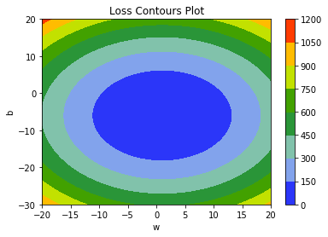
Loss Surface (3D)
Loss Contour plot(2D)
Loss
b
w

Slide 22
Loss Surface (3D)
Loss Contour plot(2D)
Loss
b
b
w
w

Slide 23
Next: Mathematics behind Gradient descent algorithm

Slide 24



